Slide 1

Basic Bitcoin Tech: Bitcoin Nodes
Host - Simplest Bitcoin Book w/ Portland.HODL

Slide 2
Overview -
Topics
What is a Bitcoin node.
What do nodes do?
Types of nodes.
How to run a node.
Extending your node.
Privacy

Slide 3
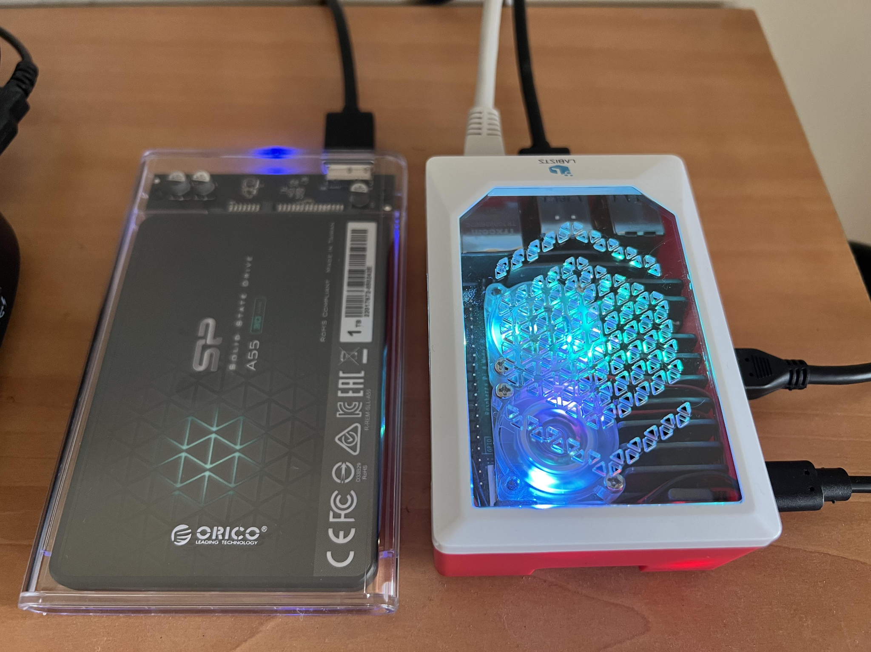
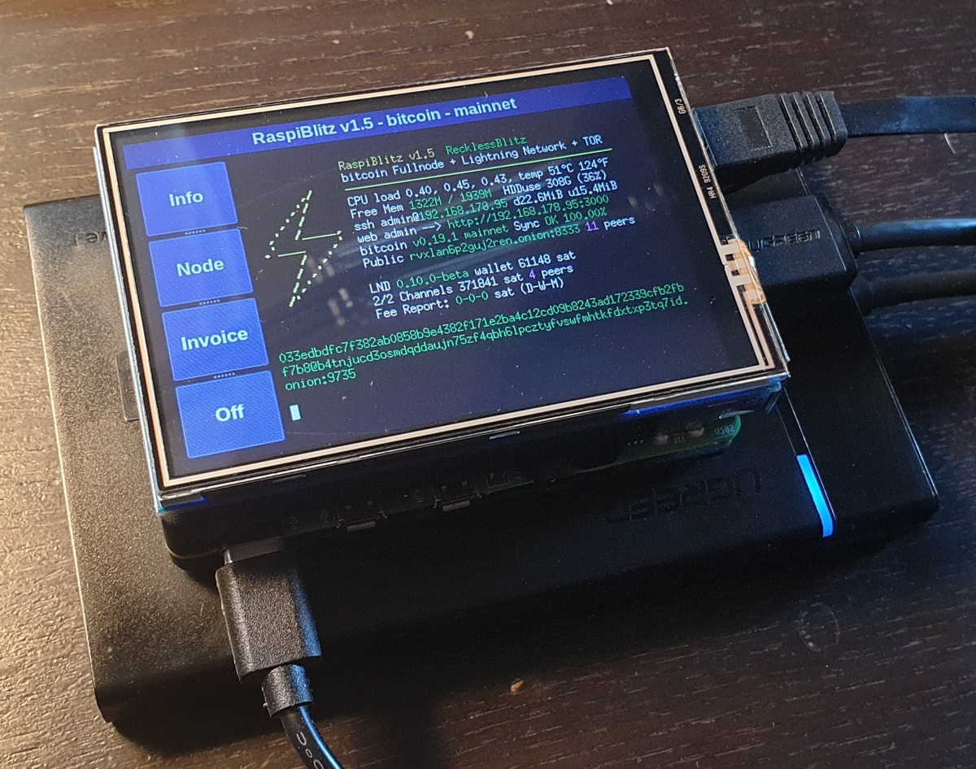
What is a Bitcoin Node?
Definition
“A full node is a program that fully validates transactions and blocks. Almost all full nodes also help the network by accepting transactions and blocks from other full nodes, validating those transactions and blocks, and then relaying them to further full nodes.” - Bitcoin.org
Tl;dr A bitcoin node is a ‘server’ that fully validates transactions and blocks.

Slide 4
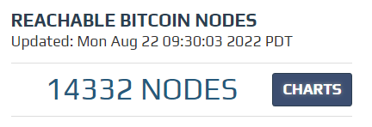
What software do nodes use?
Nearly all nodes on earth run some variation of the software ‘Bitcoin Core’. There are various versions of Bitcoin Core available but all full nodes are compatible with each other and capable of relaying transactions and the validating the timechain.

Slide 5
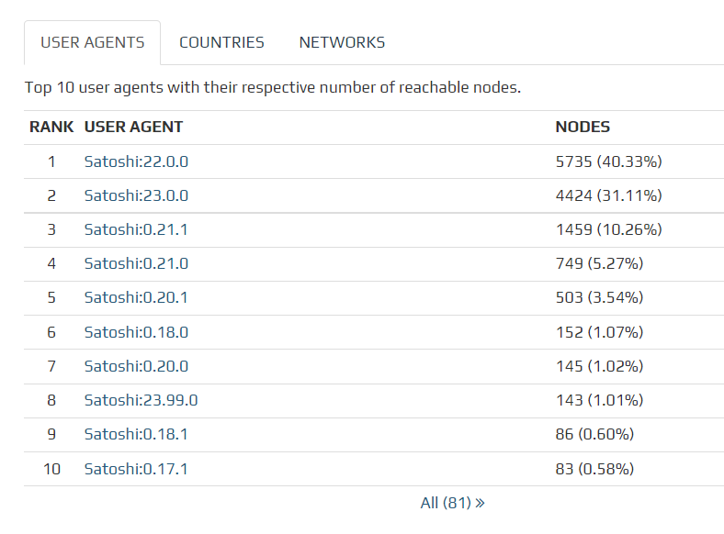
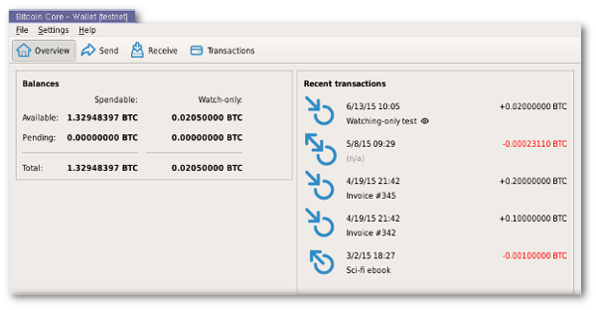
Current distribution of Node ‘Versions’
Satoshi:(xx.xx.xx) is a node that uses the Bitcoin Core reference implementation

Slide 6
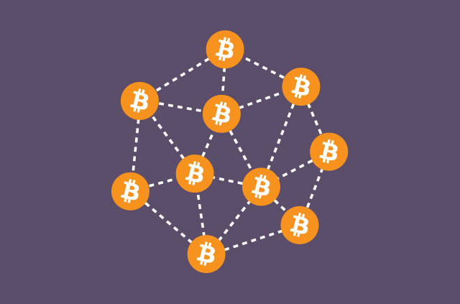
What do nodes do?
Full nodes WILL …
Relay or Validate Bitcoin transactions.
Validate newly minted blocks
Full nodes CAN …
Keep a copy of the timechain,
Create block templates for miners.
Share current and previous blocks with other nodes on the network.
Generate wallets - addresses - and show users a bitcoin balance.
Be used programmatically to get information about the timechain.

Slide 7
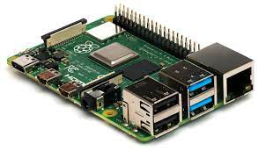

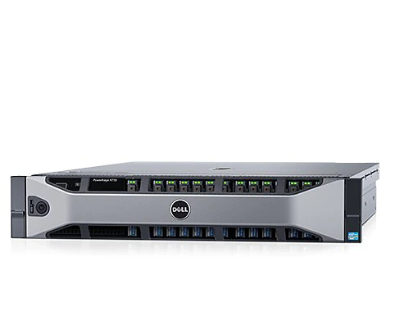
Hardware that can be used to run a node.
Bitcoin nodes can run on a variety of hardware.
Raspberry PI (Small Single Board Computer)
Laptops
Desktop Computers
Servers
Anything that can run linux …

Slide 8
Advantages of different types of node hardware

Slide 9
Raspberry Pi - Small and Efficient
Raspberry Pi Advantages ✅
Hands off after setup
Small and compact
Built in Wifi and Ethernet
Extremely low power
Raspberry Pi Disadvantages ❌
SLOW - Very very very slow.
Right now they are very ‘expensive’
Needs an external USB harddrive
Primarily uses linux*
Finicky - Lots of hardware combinations fans, sd cards, power supplies, etc …

Slide 10
Laptops - Available and Fast*
Laptop Advantages ✅
Faster than the Pi
Built in battery
Supports Windows / Mac OS / Linux
Can be dual purposed.
Built in WiFi / Ethernet.
Many people have one.
Laptop Disadvantages ❌
Bulky
Configuring it to not shut off is annoying
Uses more power than a Pi

Slide 11
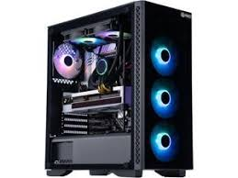
Desktops and Servers - Available and Faster*
Desktop / Server Advantages ✅
Ultra Fast - Huge Storage
High availability
Supports Windows / Mac OS / Linux
Can be dual purposed.
Desktop / Server Disadvantages ❌
Incredibly Bulky
High power consumption
Noisy

Slide 12
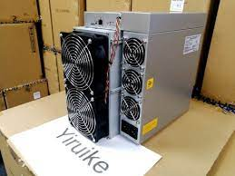
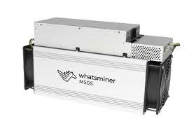
A miner uses a node but is not a node itself.

Slide 13
Types of nodes …

Slide 14
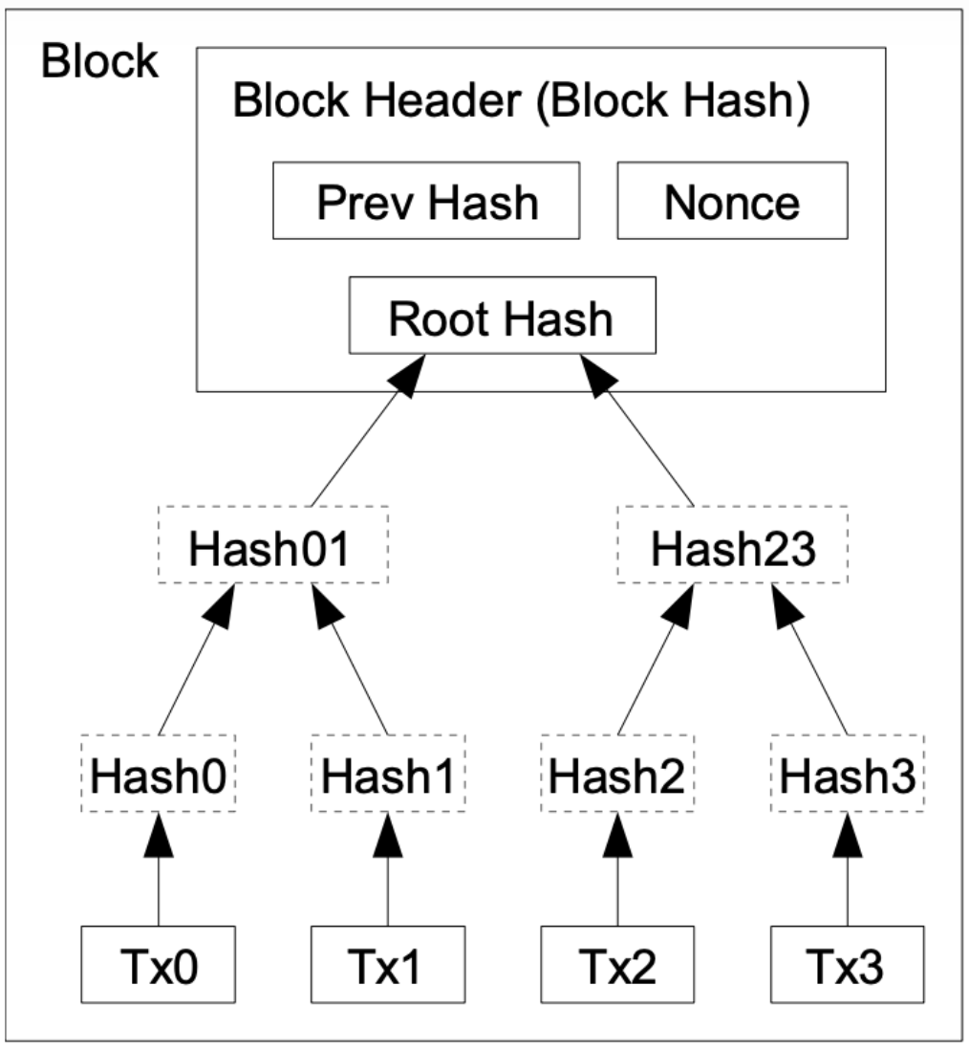
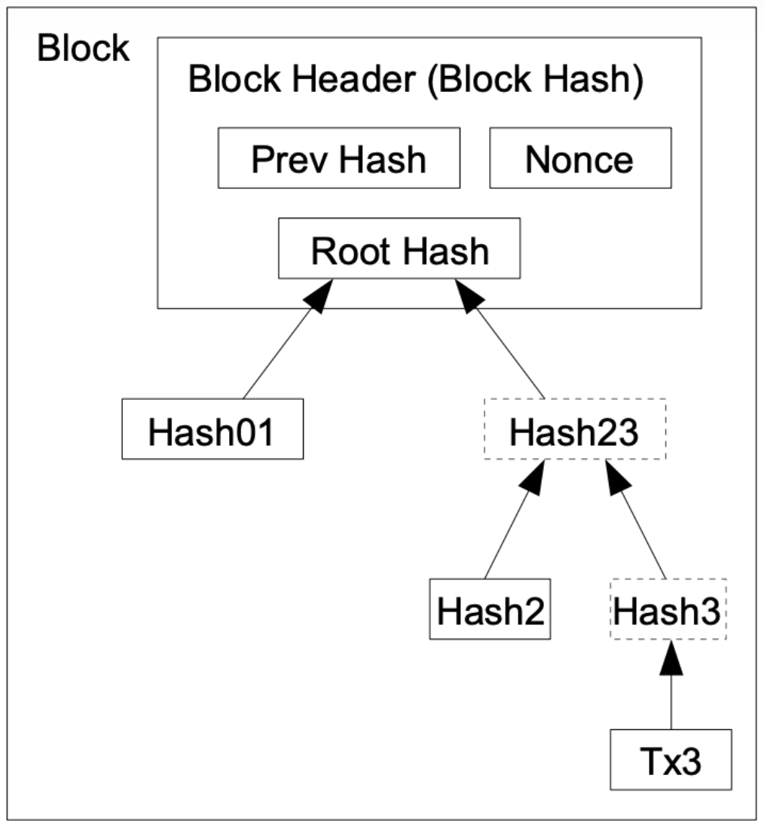
Types of Nodes
FULL NODE
Archival Node - AKA ‘listening node. A full node that contains the complete historical blockchain record going back to the Genesis block mined by Satoshi on Jan 3, 2009.
Pruned Node - A full node that substitutes part of each block with compacted blocks that are less data intensive.
LIGHT ‘NODE’ (Not really a node)
Light ‘Node’ - Does not contain a copy of the bitcoin ledger, and cannot validate transactions in the same way that a full node can.

Slide 15
Why run a node …

Slide 16

Reasons to run a node
Privacy
Trustlessly confirm your transactions
Help secure the network
Enforce the ruleset and defend Bitcoin from unwanted changes
Support the network by improving speed
Help bolster decentralization
Potential to become an ‘Uncle Jim’

Slide 17
How to run a node …

Slide 18
Determine the hardware you want to install Bitcoin Core on.
Let Bitcoin Core Sync the entire timechain. This can take up to a week on slower devices.
Start building cool stuff on top of your node!
Get Hardware
Install Bitcoin Core
Let Bitcoin Core Sync
Enjoy
Build
Install Bitcoin Core
https://bitcoincore.org
You now are running a full node.

Slide 19
Extending Your Node …

Slide 20
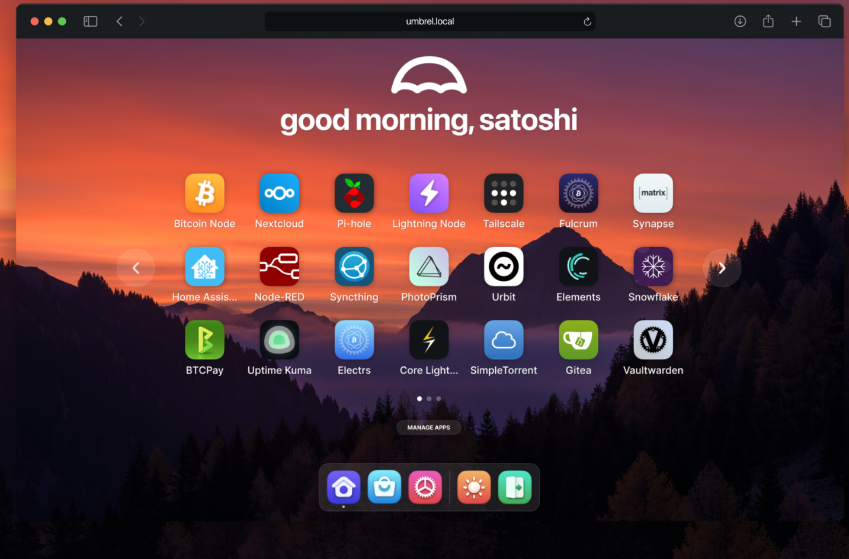

Some turn key solutions …
Umbrel
Ultra easy and a great place to get started - not perfect since Umbrel does have licensing terms that could be seen as restrictive.
Citadel
For all intents and purposes it’s Umbrel with fully open source licenses… harder to install and setup.
Other options
Ronin Dojo - Plug and play option or DIY
Start 9 Labs - Embassy Plug and Play, or DIY
RaspiBlitz - DIY

Slide 21
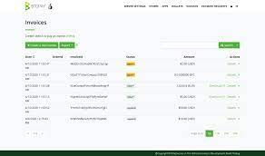
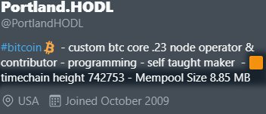
You can install apps that use Bitcoin Core
Lightning Nodes (LND - Core Lightning)
RTL - Ride the Lightning
BTC Pay Server
Custom Software
And much more!

Slide 22
Privacy And Your Bitcoin Node …
Without using a proxy, VPN, or TOR, your node will expose it’s ip v4/6 address.
This doesn’t present a risk to funds but can allow anyone to get a rough estimate of your physical location within ~50 miles max.
Ideal to use a privacy protecting setup.
Privacy is necessary for an open society in the electronic age.
Privacy is not secrecy. A private matter is something one
doesn’t want the whole world to know, but a secret matter
is something one doesn’t want anybody to know. Privacy is
the power to selectively reveal oneself to the world. - Eric Hughes, A Cypherpunk’s Manifesto, 1993

Slide 23
Thanks For Listening.
Questions or Comments? Please ask to come on stage.
Anything incorrect please comment on the slide in question.

